Slide 1
飲用水水質監控
邱泓儒

Slide 2
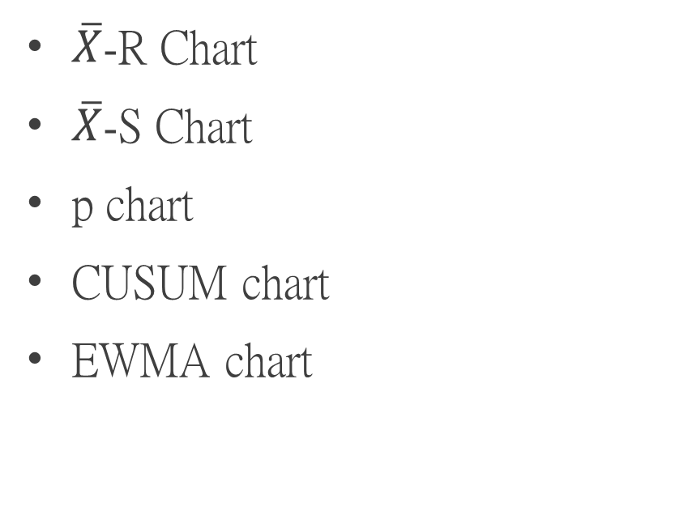
報告大綱
資料簡介
品質管制圖
結論與討論
資料介紹
水質指標簡介
簡單資料視覺化
$\overline{X}$-R Chart
$\overline{X}$-S Chart
p chart
CUSUM chart
EWMA chart

Slide 3
資料介紹
ph | Hardness | Solids | Chloramines | Sulfate | Conductivity | Organic_carbon | Trihalomethanes | Turbidity | Potability
 | 204.8905 | 20791.32 | 7.300212 | 368.5164 | 564.3087 | 10.37978 | 86.99097 | 2.963135 | 0
3.71608 | 129.4229 | 18630.06 | 6.635246 |  | 592.8854 | 15.18001 | 56.32908 | 4.500656 | 0
8.099124 | 224.2363 | 19909.54 | 9.275884 |  | 418.6062 | 16.86864 | 66.42009 | 3.055934 | 0
8.316766 | 214.3734 | 22018.42 | 8.059332 | 356.8861 | 363.2665 | 18.43652 | 100.3417 | 4.628771 | 0
9.092223 | 181.1015 | 17978.99 | 6.5466 | 310.1357 | 398.4108 | 11.55828 | 31.99799 | 4.075075 | 0
5.584087 | 188.3133 | 28748.69 | 7.544869 | 326.6784 | 280.4679 | 8.399735 | 54.91786 | 2.559708 | 0
10.22386 | 248.0717 | 28749.72 | 7.513408 | 393.6634 | 283.6516 | 13.7897 | 84.60356 | 2.672989 | 0
8.635849 | 203.3615 | 13672.09 | 4.563009 | 303.3098 | 474.6076 | 12.36382 | 62.79831 | 4.401425 | 0
 | 118.9886 | 14285.58 | 7.804174 | 268.6469 | 389.3756 | 12.70605 | 53.92885 | 3.595017 | 0
11.18028 | 227.2315 | 25484.51 | 9.0772 | 404.0416 | 563.8855 | 17.92781 | 71.9766 | 4.370562 | 0

Slide 4
水質指標
物理性指標
水溫、臭與味、色度、濁度(Turbidity)、Solids、導電性(Conductivity)
化學性指標
pH值、硬度(Hardness)、Sulfate 、 Chloramines、 Organic_carbon、 Trihalomethanes
生物性指標
Bacteria、 Viruses

Slide 5
水質指標-濁度(Turbidity)
It is a measure of the ability of light to pass through water
NTU (Nephelometric Turbidity Units)
shouldn't be more than 5 NTU

Slide 6
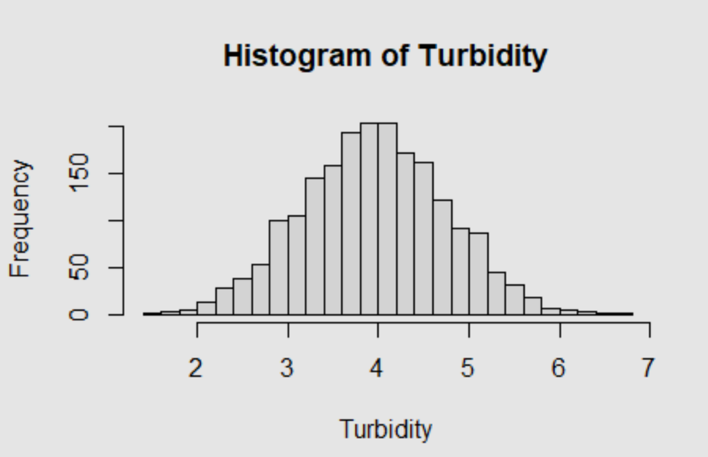
Histogram

Slide 7
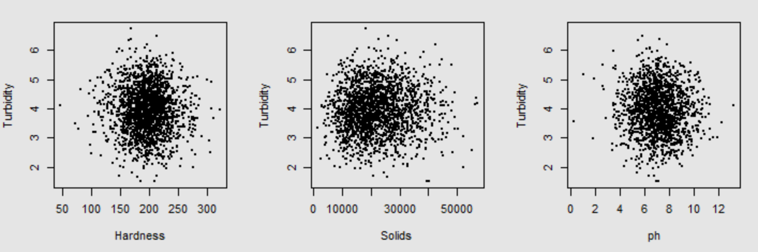
Scatter plots

Slide 8
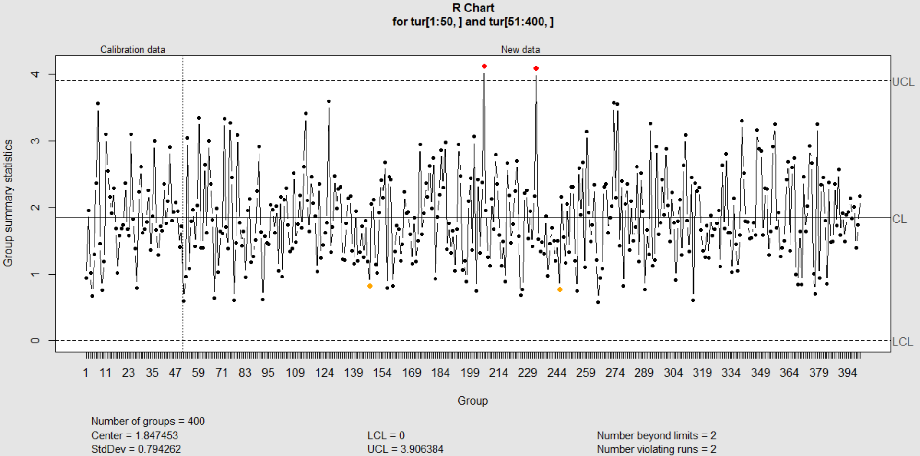

$\overline{X}$-R Chart:R Chart

Slide 9
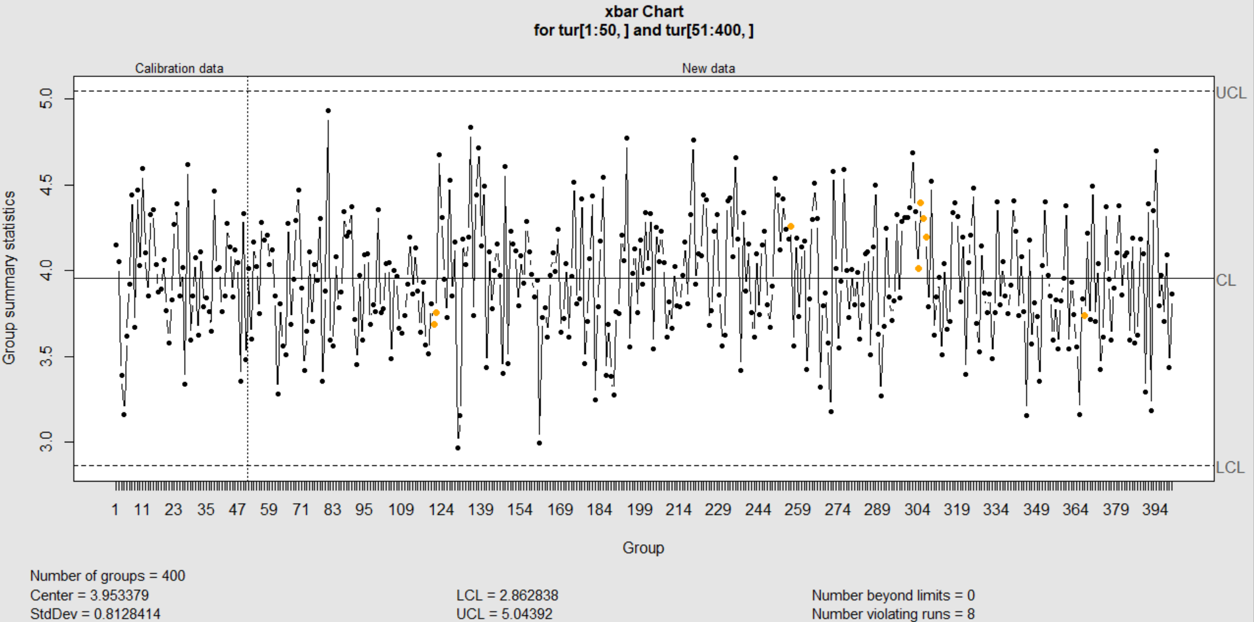

$\overline{X}$-R Chart:$\overline{X}$ Chart

Slide 10
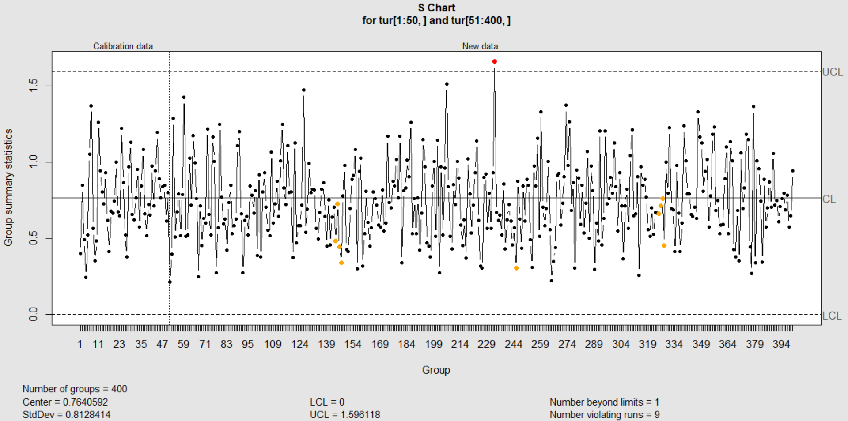

$\overline{X}$-S Chart:S Chart

Slide 11
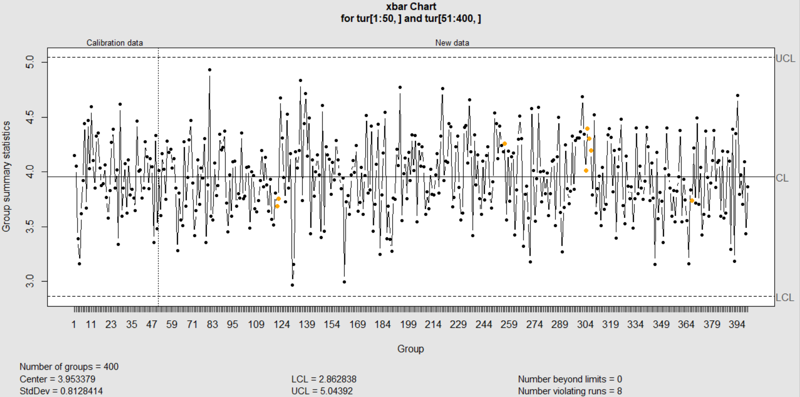

$\overline{X}$-S Chart:$\overline{X}$ Chart

Slide 12

$p$Chart
Potability
Indicates if water is safe for human consumption.
Potable -1 and Not potable - 0

Slide 13
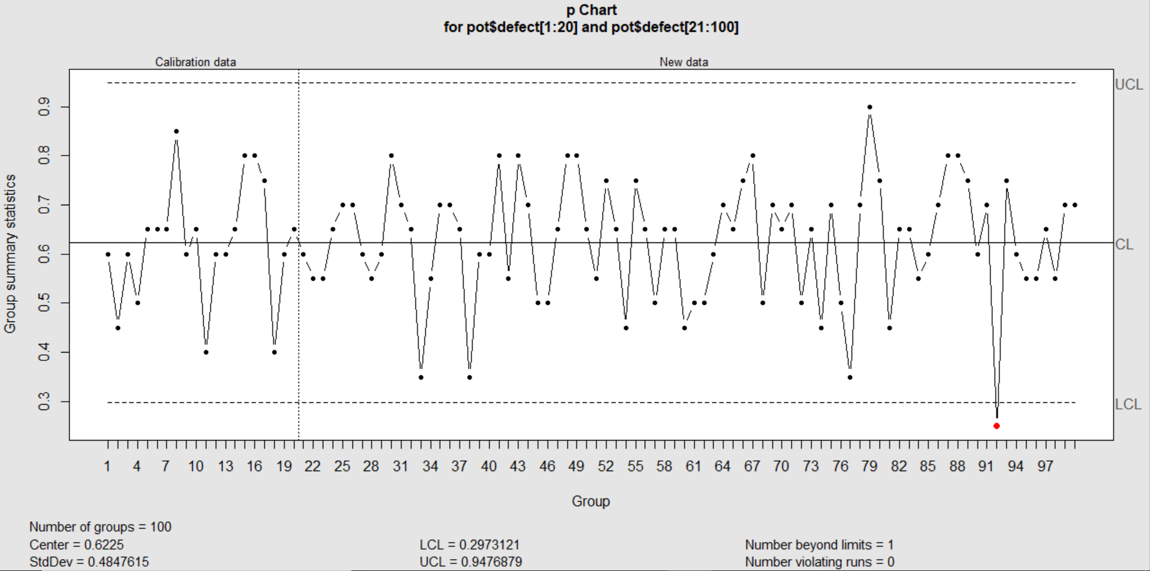
$p$Chart

Slide 14
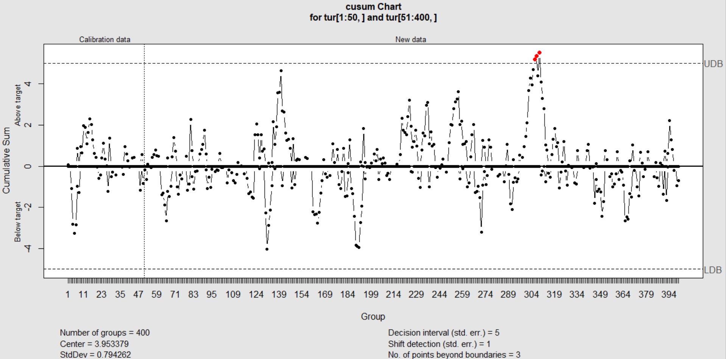
cumsum Chart
H = 5σ
K = 0.5σ

Slide 15
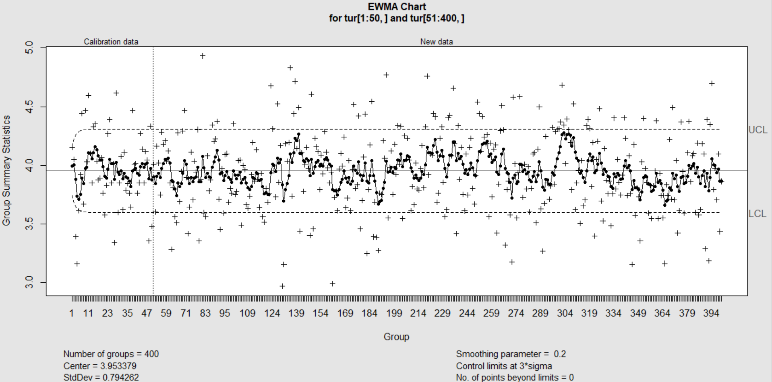
EWMA Chart
λ= 0.2
L = 3

Slide 16
THANK YOU!

